Slide 1
Yesterday we looked at the area of squares an rectangles, today we are looking at the area of triangles and parallelograms.
Revision from yesterday;
12cm
Area=
4cm
https://www.geogebra.org/m/wPHZ2VcU
https://www.geogebra.org/m/MyVgfMAg

Slide 2
Let’s try a few triangles to see how much area they take up.
We have a square that is 5cm x 5cm.
It’s area is 5x5 = 25cm²
Our triangle is also 5cm tall x 5cm wide. How many area squares does it take op?

Slide 3
Let’s try a few triangles to see how much area they take up.
We have a square that is 5cm x 5cm.
It’s area is 5x5 = 25cm²
This triangle is also 5cm tall x 5cm wide. How many area squares does this triangle take up?

Slide 4
This triangle is also 5cm tall x 5cm wide. How many area squares does this triangle take up?

Slide 5
24
7
30
Area
Date
EQ – How do I find the area of triangles and parallelograms?
How do I find the area of triangles
Area = (Base x Height) $÷2$
Height
Height
Base
Base

Slide 6
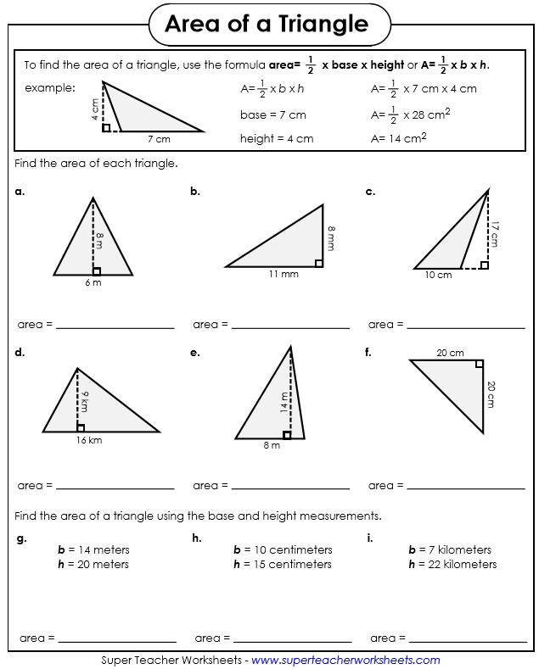
I DO

Slide 7
WE DO

Slide 8
YOU DO

Slide 9
A parallelogram is a quadrilateral (4 sided shape) that has 2 sets of parallel sides.
Think of it as a rectangle that has been pushed slightly on one corner.
https://www.geogebra.org/m/m8EdKBj5

Slide 10
Let’s see how this looks.
A rectangle that is 6 x 3cm takes up 18cm².

Slide 11
Let’s see how this looks.
A rectangle that is 6 x 3cm takes up 18cm².
What about a paralellogram that is 6cm long and reaches 3cm high.

Slide 12
Let’s see how this looks.
A rectangle that is 6 x 3cm takes up 18cm².
What about this paralellogram that is also 6cm long and reaches 3cm high.

Slide 13
24
7
30
Area
Date
EQ – How do I find the area of triangles and parallelograms?
How do I find the area of triangles?
Area = (Base x Height) $÷2$
Height
Height
Base
Base
How do I find the area of parallelograms?
Area = Base x Height
Height
Base

